Slide 1


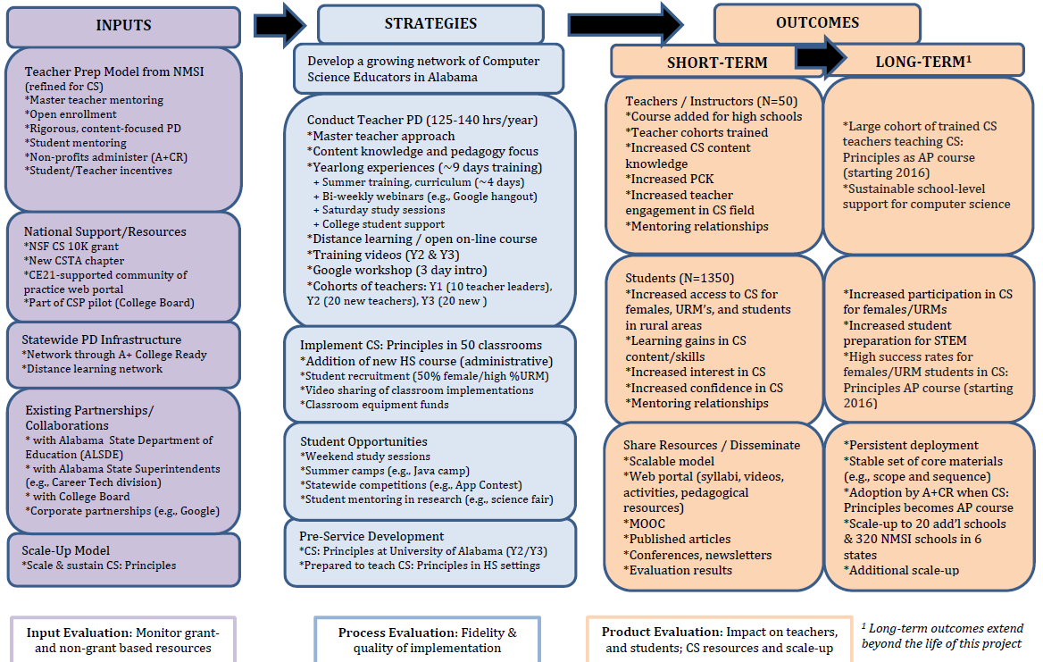
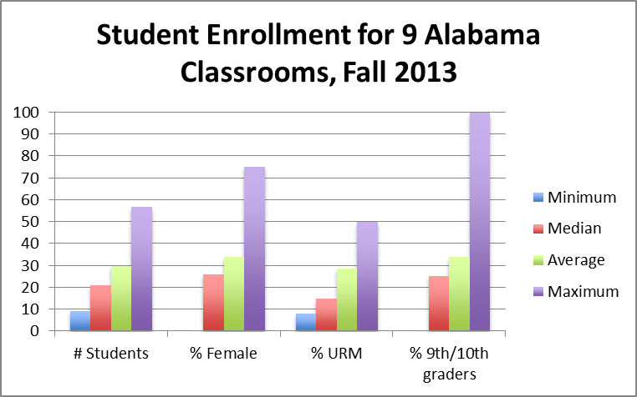
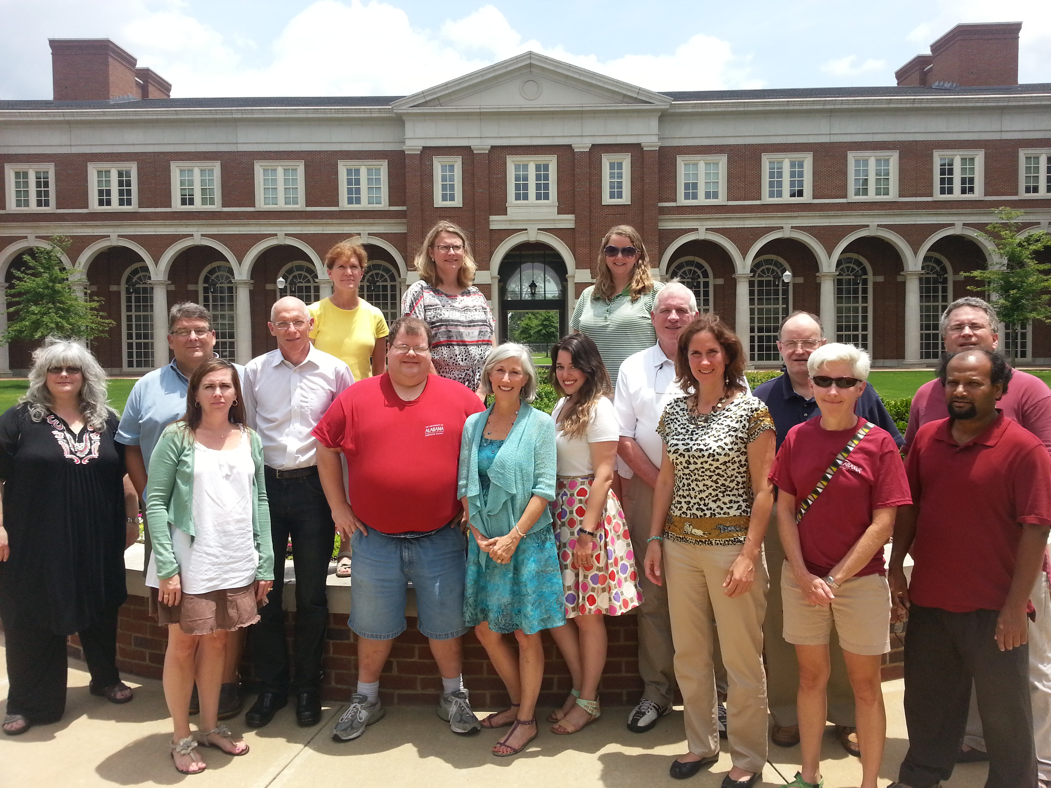
A Model for Statewide Deployment of CS Principles Courses
LONG LIST of names HERE!!!!
http://csprinciples.cs.ua.edu
This project is supported by NSF Award #1240944.
Motivation and project goals
CS4Alabama Logic Model
Motivation and Background
Alabama participation in AP CS A traditionally low (<100 students per year over past 5 years)
Yet, clusters of national tech leadership (Huntsville #4 in USA, per capita, in STEM workers)
Successful AP Training and Incentive Program across Alabama high schools, as implemented by A+ College Ready as part of the National Math and Science Initiative:
Alabama’s success in improving AP math, science and English scores from 2008-2011 for both all students and minority students leads the nation (% increase in qualifying scores).
University of Alabama participation as an NSF/College Board CS Principles Pilot Site (Pilot II-IV); sharing of results with southeast teachers through Google CS4HS support
Project Goals and Scope
Train 50 high school teachers through extended Professional Development (beyond 1-week APSI) over a three-year period, while introducing 2,500 students to CS Principles content
Sustainability and scalability through leverage and continued adoption of A+ College Ready
Broadening participation through open access to AP courses using the NMSI model
Dissemination of curricular materials and results of evaluation assessments to support PD
Activities and implementation details
The project is driven by the following core activities: 1) Master Teacher mentoring and vertical teaming using face-to-face and online collaboration; 2) Open enrollment to increase diversity of participation; 3) Rigorous course content for year-long professional development; 4) Student mentoring through weekend skills development; 5) Incentives for teachers and students.
Initial evaluation results
Course enrollment for the 10 pilots ranged from 10 students to 95 students, with a median enrollment of 27 students at each school.
The average percentage of female students is 34% (max 75% in one school); underrepresented students average is 29% (max 50%) in one school; Cohort 2 schools will have higher URM participation compared to Cohort 1.
Year 1: Ten Teacher Leaders with CS AP experience assist in developing CS Principles curricula resources and Piloting a course
Years 2 and 3: Twenty teachers each year collaborate with assigned Teacher Leaders for year-round professional development and mentoring while introducing a new Pilot
Undergraduate students in both CS and Education pre-service teachers, and a CS PhD student, assist PIs in training and curricular development resources
Only one performance task has been completed across all Pilots before winter break (Internet/Explore task). Many of the teachers have reported their students have challenges with the reflective writing portion of the performance tasks. This is particularly true when the course is offered to 9th graders.
CS4Alabama Teacher Leaders
Summer 2013 PD Workshop

